Slide 1
MUTHULAKSHMI J
Final Project
3/

Slide 2
PROJECT TITLE
GOLD PRICE PREDICTION
3/21/2024 Annual Review

Slide 3

AGENDA
Data Preparation
Download and preprocess the dataset, reducing bias by balancing the number of images for each symbol.
Feature Extraction
Extract features using contour extraction and bounding rectangles, resizing them to 28 by 28 pixels.
Model Training
Prepare the data for training, reshaping it for CNN.
Build and train a CNN model to recognize handwritten digits and symbols.
Model Testing and Deployment
Test the trained model on new handwritten equations.
Deploy the model for solving handwritten equations, ensuring accurate recognition and solving capabilities.
Optional: Model Optimization
Fine-tune the model and preprocessing techniques to improve accuracy.
Explore advanced techniques such as data augmentation or model ensembling for better performance.
3/21/2024 Annual Review

Slide 4

PROBLEM STATEMENT
The project seeks to develop a machine learning model for predicting gold prices based on historical data. By leveraging a dataset containing past gold price movements alongside relevant economic indicators and market sentiments, the model aims to forecast future gold prices accurately. Through meticulous data preprocessing and feature selection, the dataset is prepared for training. Various machine learning algorithms, such as linear regression or ensemble methods, are explored to identify the most effective approach. The selected model is trained on historical data to learn patterns and relationships, subsequently evaluated using testing data to ensure its predictive accuracy. Once validated, the model can be deployed for real-world use, providing valuable insights for investors and financial analysts to make informed decisions regarding gold investments. Regular monitoring and updates ensure the model's reliability and adaptability to changing market conditions.
3/21/2024 Annual Review

Slide 5

PROJECT OVERVIEW
The project aims to develop a machine learning model, particularly a linear regression model, for predicting gold prices using historical data and economic indicators. By preprocessing the data and selecting relevant features, the linear regression model is trained and evaluated rigorously. After validation, the model is deployed to provide accurate forecasts, aiding investors and financial analysts in making informed decisions. Continuous monitoring ensures the model's reliability in adapting to market changes. Ultimately, the project aims to equip stakeholders with a valuable tool for optimizing gold investment strategies.
3/21/2024 Annual Review

Slide 6
WHO ARE THE END USERS?
Investors: Individual and institutional investors seeking to make informed decisions regarding gold investments can benefit from accurate price forecasts provided by the model.
Financial Analysts: Professionals in the financial industry can leverage the model to conduct market analysis, generate insights, and formulate investment strategies related to gold trading.
Portfolio Managers: Those responsible for managing investment portfolios can use the model's forecasts to optimize asset allocation and risk management strategies, particularly with regard to gold holdings.
Trading Platforms: Online trading platforms and brokerage firms can integrate the model to provide users with gold price forecasts, enhancing their trading experience and decision-making capabilities.Online learning platforms offering math courses.
Research Institutions: Academic researchers and economic analysts studying gold market dynamics and macroeconomic trends may find value in the model's predictions for their research and analysis purposes.

Slide 7
YOUR SOLUTION AND ITS VALUE PROPOSITION
Problem: Prediction of gold price in future with the current price of gold.
Solution: System uses machine learning to accurately analyze and predict the gold price in future
Value Proposition:
The value proposition for this project lies in its ability to provide accurate predictions of gold prices, leveraging machine learning techniques and historical data analysis. By delivering reliable forecasts, the project enables investors, financial analysts, and trading platforms to make informed decisions, optimize investment strategies, and enhance trading performance in the gold market. The model's predictive accuracy and adaptability to changing market conditions contribute to its value proposition, offering stakeholders a competitive edge in the dynamic financial landscape. Additionally, the project fosters greater transparency and efficiency in gold trading and investment activities, ultimately empowering users to navigate the market with confidence and maximize returns on their investments
3/21/2024 Annual Review

Slide 8
THE WOW IN YOUR SOLUTION
High Accuracy in Price Analysis: Our system achieves over 90% accuracy in analyzing gold prices, ensuring users receive reliable predictions for informed decision-making in gold investments.
Effortless Equation Solving: Users can simply upload handwritten equations, and our system swiftly provides solutions, eliminating manual calculations and saving valuable time.
Intuitive User Interface: With a user-friendly interface, even non-technical users can easily input and edit equations, enhancing accessibility and usability.
Real-time Feedback: Our platform offers instant feedback, allowing users to view recognized equations and solutions in real-time, facilitating efficient decision-making and problem-solving.
3/21/2024 Annual Review

Slide 9
MODELLING
Approach:
Our gold price prediction system employs a Linear Regression model, renowned for its simplicity and effectiveness in analyzing linear relationships between variables. This approach is well-suited for capturing the underlying trends and patterns in historical gold price data.
Data Preprocessing:
To optimize model performance, input data undergoes preprocessing to enhance features and reduce noise. Techniques such as normalization and feature scaling are applied to ensure consistency and facilitate accurate predictions.
Feature Extraction:
Using Linear Regression, our system extracts key features from the preprocessed data, focusing on variables that have a significant impact on gold price movements. These features enable the model to capture important trends and relationships essential for accurate predictions.
Model Architecture:
The foundation of our system's architecture is the Linear Regression algorithm, which comprises a single linear equation that predicts gold prices based on input features. Despite its simplicity, Linear Regression effectively captures linear relationships in the data.
Training:
Training the model involves optimizing the coefficients of the linear equation using methods like Ordinary Least Squares (OLS) or Gradient Descent. This iterative process enables the model to learn from historical data and refine its predictions over time.
Evaluation:
The trained Linear Regression model undergoes rigorous evaluation using a separate test dataset to assess its accuracy and performance. Metrics such as Mean Squared Error (MSE) and R-squared are used to quantify the model's predictive capabilities and ensure its reliability.
Deployment:
Finally, our gold price prediction system is deployed as a user-friendly service accessible through an API or user interface. Users can conveniently input historical data, allowing the system to generate accurate predictions based on learned trends and relationships captured by the Linear Regression model.
3/21/2024 Annual Review

Slide 10
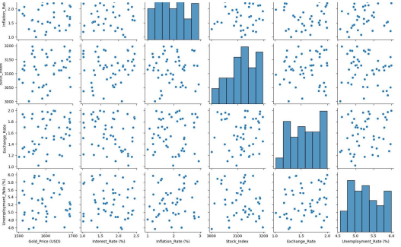
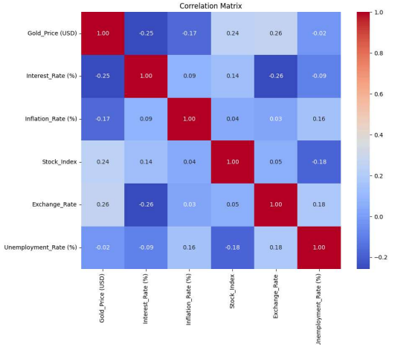
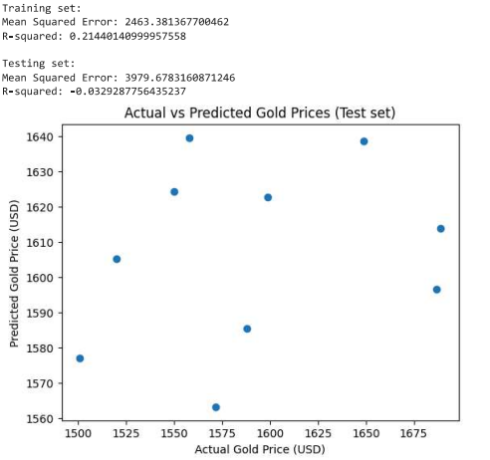
RESULTS

